Slide 1
Introduction to
Seismic Waveform Inversion Toolbox-1.0
Haipeng Li @ USTC
July 2021

Slide 2
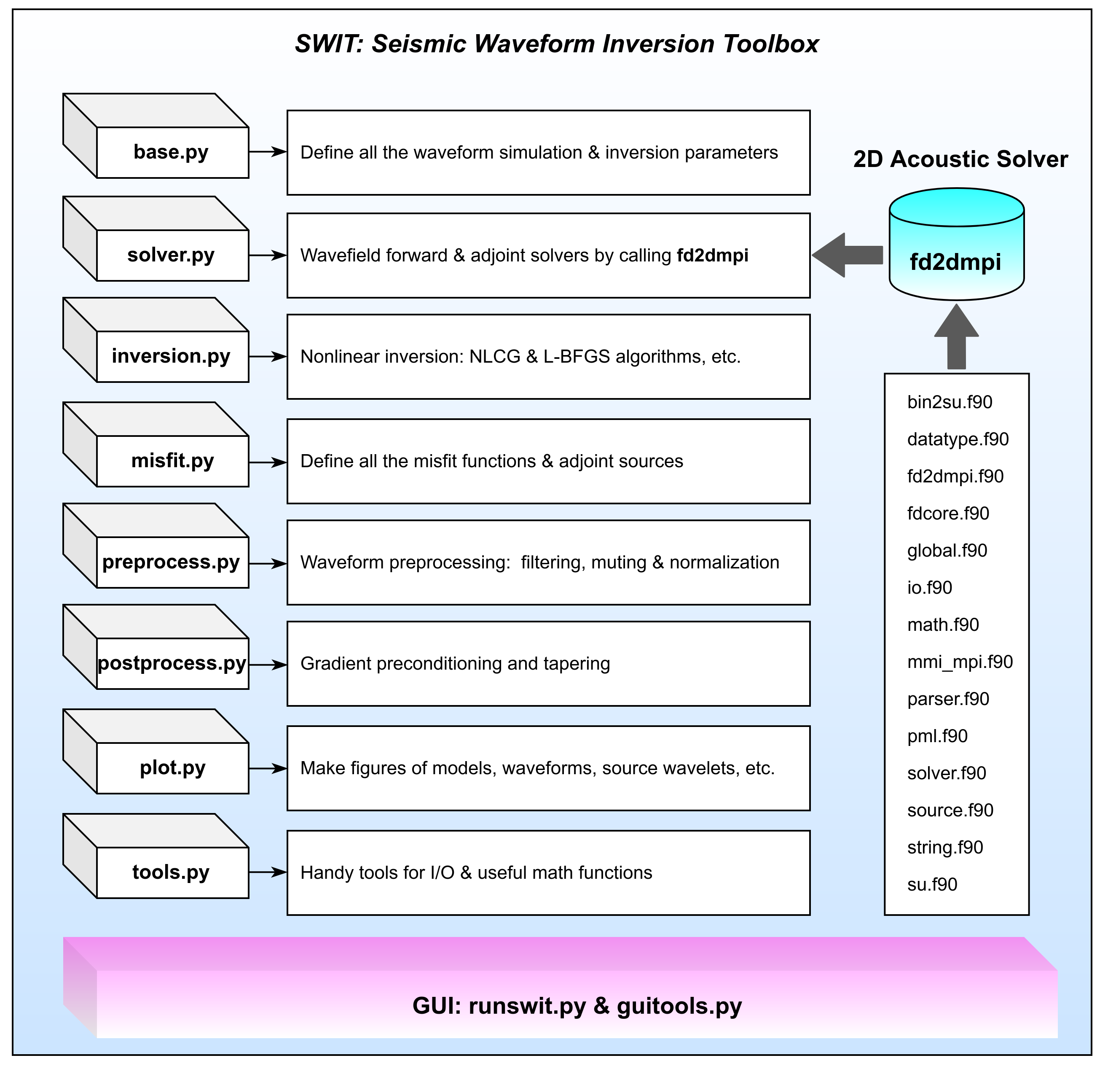
Structures of SWIT
Haipeng Li & Junlun Li, in preparation

Slide 3
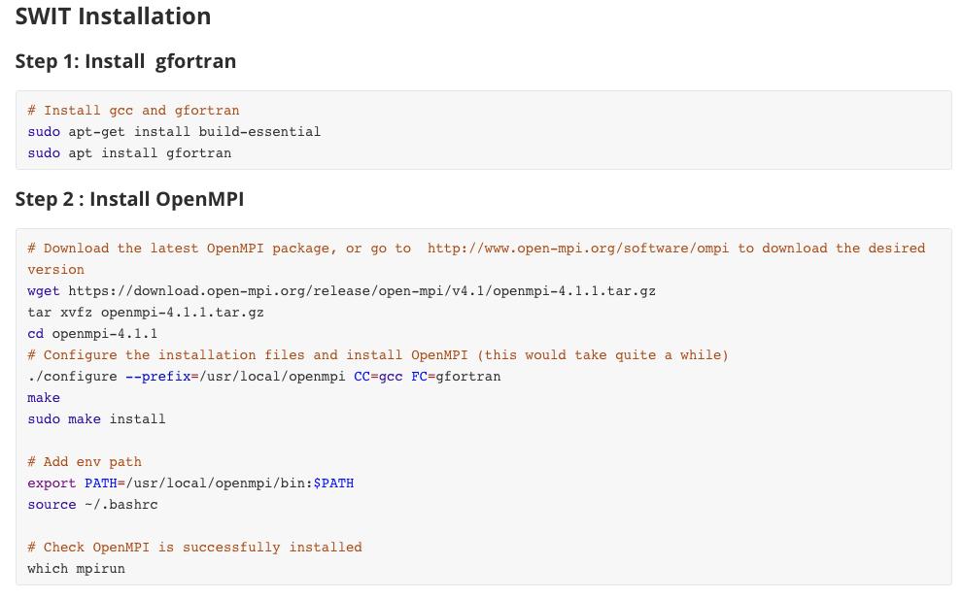
Installation of SWIT

Slide 4
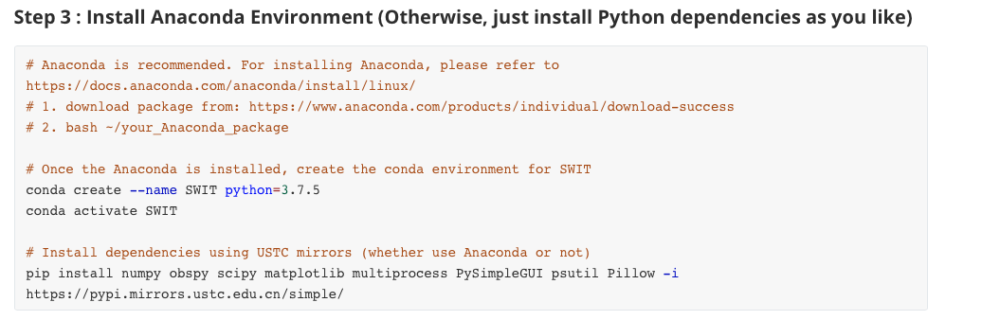
Installation of SWIT

Slide 5
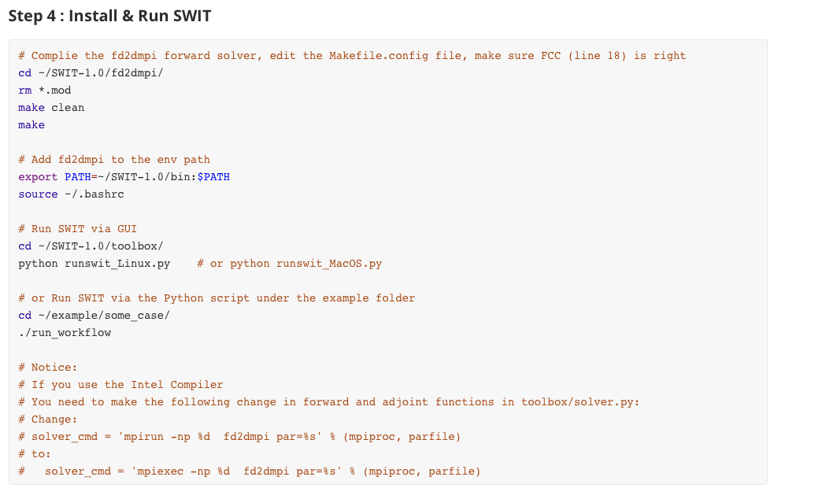
Installation of SWIT

Slide 6
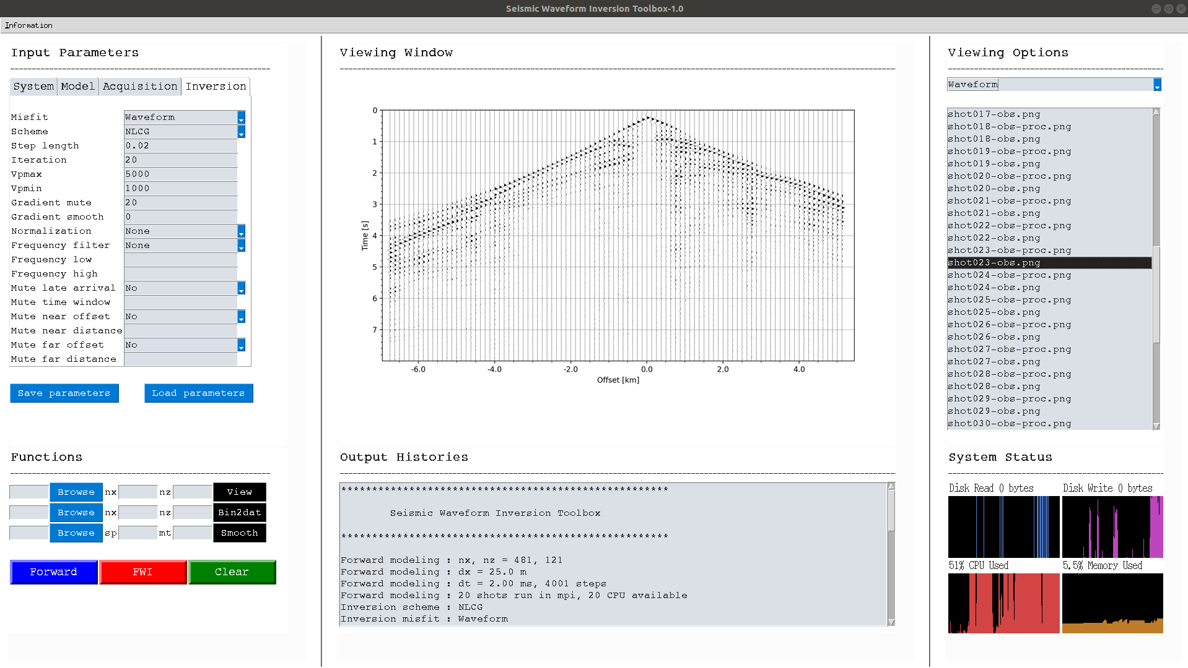
1. Input Parameters
2. Viewing Window
3. Viewing Options
3. Functions
4. Output Histories
6. System Status

Slide 7
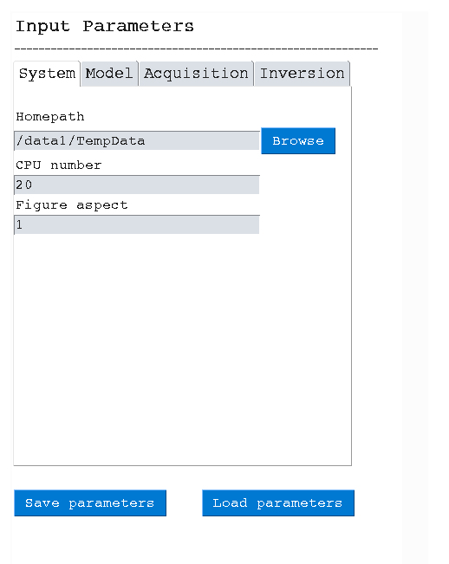
Parameters for System
Project working folder
CPU number for MPI
Figure aspect for plotting
Save parameters in file
Load previously saved parameter file

Slide 8
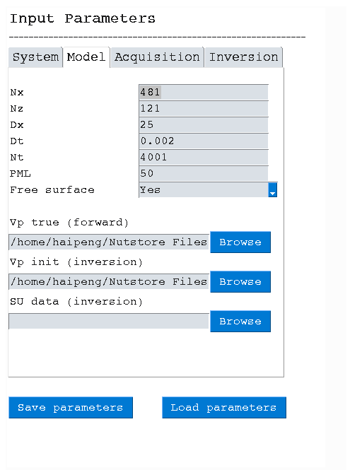
Parameters for Model
Model size along x direction
Model size along z direction
Grid size (in m)
Temporal step (in s)
Total time steps
PML size, use a relatively large one, i.e., 50
Set free surface or not
True Vp model saved in the txt file
Initial Vp model saved in the txt file
Field-data path, data should be named as: src1_sg.su, src2_sg.su, ..., src40_sg.su, ...
Synthetic FWI requires: Vp true & Vp init
Field-data application requires: Vp init & SU data

Slide 9
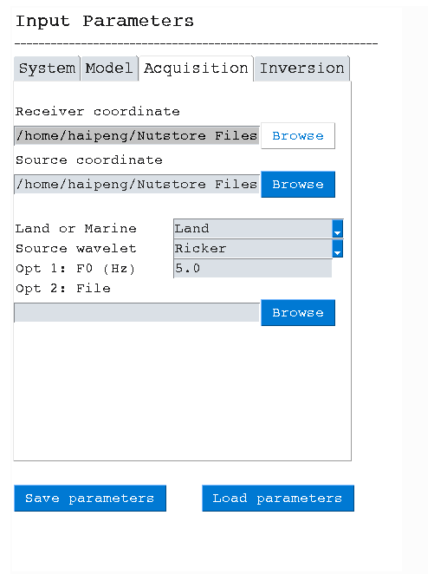
Parameters for Acquisition
Receiver file, see examples for detailed format
Source file, see examples for detailed format
Acqusition type: land or marine
Source wavelet: Ricker or from file
If Ricker, set the dominant frequency
If from file, set the file path

Slide 10
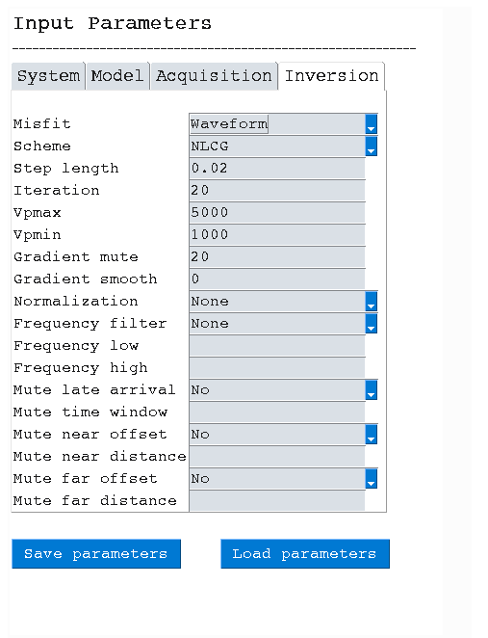
Parameters for Inversion
Set misfit function: Waveform, Traveltime, etc.
Set optimization scheme: NLCG or L-BFGS (NLCG is recommended)
Set step length, i..e, 0.01 or 0.02 (with respect to Vp model)
Set number of iteration
Maximum Vp (in m/s)
Minimum Vp (in m/s)
Set gradient mute. In marine case, it’s the water layer size; in land case, set as ~10 (in grid)
Set gradient smoothing size, i.e., 10 (in grid)
Set whether to normalize the data. If so, set which type
Set whether to filter the data. If so, set which type
Set the low frequency bound (in Hz)
Set the high frequency bound (in Hz)
Set whether to mute late arrivals based on the automatically picked first break
Set the time window after the first break, i.e., 1.0 (in s)
Set whether to mute traces of near offset
Set the distance to mute near offset distance (in m)
Set whether to mute far offset
Set the distance to mute traces of far offset distance (in m)

Slide 11
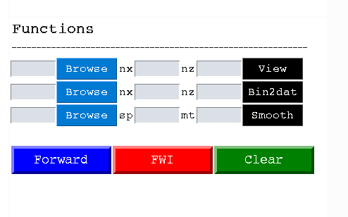
Functions
View a txt file (donot require nx & nz) or binary file (require nx & nz)
Convert a binary file to a txt file (require nx & nz)
Smooth a txt file. sp: the smoother radius; mt: the top mute for any water layer
Forward: Run forward modeling on the provided true model to generate the synthetic dataset
FWI: Run FWI and the initial model and the SU data should be both prepared.
Clear: clear the output histories
For syn-model FWI: provide Vp true & Vp init. Run Forward and then run FWI
For field-data FWI: provide Vp init & SU data. Run FWI

Slide 12
Other issues
SWIT solves the variable-density acoustic wave equation in the stress-velocity form;
SWIT uses a 4th-order Butterworth filter (zero-order);
SWIT mutes the late arrivals based on the automatically picked first break in a brutal way;
SWIT does not support the arbitrary arrangement of receivers for different sources yet.

